Slide 1
Department of Computer Science and Engineering (CSE)
INSTITUTE : UIE
DEPARTMENT : CSE
Bachelor of Engineering (Computer Science & Engineering)
Programming in Python Lab
(23CSP-201)
DISCOVER . LEARN . EMPOWER

Slide 2
Department of Computer Science and Engineering (CSE)
Course Outcome
CO1 | Describe the basic fundamentals of python programming.
CO2 | Apply the python programming for Arithmetic, Logical and sorting operations.
CO3 | Analyze python programming loops & methods for data manipulation.
CO4 | Use the Python programming language for various programming techniques like list, tuples, dictionaries etc.
CO5 | Develop application software using object-oriented programming techniques in the Python language.
Will be covered in this lecture

Slide 3
Contents of the Syllabus
Department of Computer Science and Engineering (CSE)
UNIT-1 | Python Fundamentals |  | 16 Hours
Experiment 1.1 | Writing Python programs, basic data types (int, float, complex, bool, string), variables, and built-in functions (id(), type(), range()).
Experiment 1.2 | Operators (arithmetic, relational, logical, etc.), control structures (if, if-else, loops), and control transfer statements (break, continue, pass).
Experiment 1.3 | Functions, arguments (positional, default, keyword, variable-length), return values, and scope (local/global variables).
UNIT-2 | Operations on Strings, list, Tuples, Sets & Dictionaries | 16 Hours
Experiment 2.1 | String operations and methods (indexing, slicing, len(), strip(), find(), replace(), split(), join(), etc.).
Experiment 2.2 | List creation, accessing, and operations (append (), insert(), extend(), remove(), pop(), sort(), etc.).
Experiment 2.3 | Tuple creation, accessing, and operations: Demonstrate various methods of creating tuples, accessing tuple elements through indexing and slicing, and applying tuple methods/functions.
Experiment 2.4 | Sets and Dictionaries creation, accessing, and operations.
UNIT-3 | Searching, Sorting, OOP, and File Handling | 16 Hours
Experiment 3.1 | Searching algorithms (linear, binary) and sorting techniques (bubble, insertion, selection, merge, quick).
Experiment 3.2 | Object-Oriented Programming: classes, methods, inheritance, and polymorphism.
Experiment 3.3 | File handling: reading, writing, and manipulating files in various modes.

Slide 4
OBJECTIVES
Department of Computer Science and Engineering (CSE)
At the completion of this Chapter , students should be able to do the following:
•Understand the role of Python in modern software development and its applications in various fields.
•Comprehend basic Python concepts, including data types, variables, and control structures.
•Grasp the fundamentals of Python syntax, program structure, and the execution model of the Python interpreter.

Slide 5
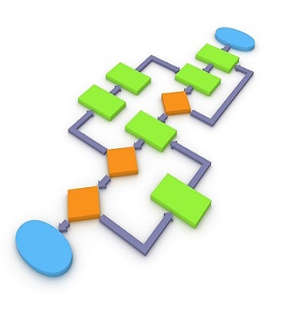

Problem Solving using Python

Slide 6
Problem Solving
Developing problem solving skills in programming is very important because the success of any task assigned to you depends on how accurately you define the problem to design and implement a solution.

Slide 7
Why do We Need to Have Problem Solving Skills?

Slide 8
How to Develop Problem Solving Skills in Programming?

Slide 9
To develop problem solving skills in programming, you need to go through a series of steps. Here are the steps to follow to resolve a problem:

Slide 10
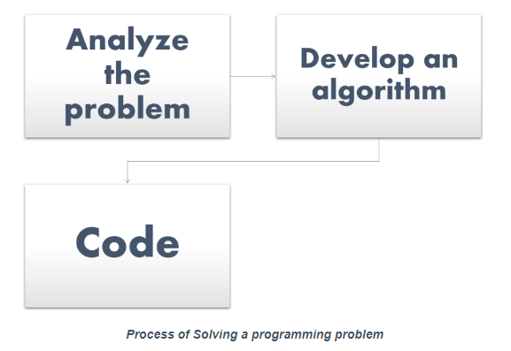

Slide 11
Why Python is popular in industry
Web development: Python is a popular choice for web development because it is easy to use, has a large library of web frameworks, and is efficient. Some popular Python web frameworks include Django, Flask, and Pyramid.
Data science: Python is a popular choice for data science because it has a number of powerful libraries for data analysis and machine learning. Some popular Python libraries for data science include NumPy, Pandas, and Scikit-learn.
Machine learning: Python is a popular choice for machine learning because it has a number of powerful libraries for machine learning. Some popular Python libraries for machine learning include TensorFlow, PyTorch, and scikit-learn.
Artificial intelligence: Python is a popular choice for artificial intelligence because it is easy to use and has a large library of AI libraries. Some popular Python libraries for AI include TensorFlow, PyTorch, and OpenAI Gym.

Slide 12
Career Opportunities
Python is a versatile programming language that is used in a wide variety of industries, making it a great choice for a career. Here are some of the most popular career opportunities for Python developers:
Software Engineer: Software engineers are responsible for designing, developing, and testing software applications. Python is a popular language for software development, as it is easy to learn and use, and it is very versatile. Software engineers with Python skills can find jobs in a variety of industries, including healthcare, finance, and technology.
Data Scientist: Data scientists are responsible for collecting, analyzing, and interpreting data. Python is a popular language for data science, as it is well-suited for data manipulation and analysis. Data scientists with Python skills can find jobs in a variety of industries, including healthcare, finance, and marketing.
Machine Learning Engineer: Machine learning engineers are responsible for developing and deploying machine learning models. Python is a popular language for machine learning, as it is easy to use and has a large library of machine learning libraries. Machine learning engineers with Python skills can find jobs in a variety of industries, including healthcare, finance, and retail.

Slide 13
Career Opportunities
Web Developer: Web developers are responsible for developing and maintaining websites and web applications. Python is a popular language for web development, as it is easy to learn and use, and it is very versatile. Web developers with Python skills can find jobs in a variety of industries, including e-commerce, media, and education.
DevOps Engineer: DevOps engineers are responsible for automating the software development and deployment process. Python is a popular language for DevOps, as it is easy to use and has a large library of automation libraries. DevOps engineers with Python skills can find jobs in a variety of industries, including healthcare, finance, and technology.
These are just a few of the many career opportunities that are available to Python developers

Slide 14
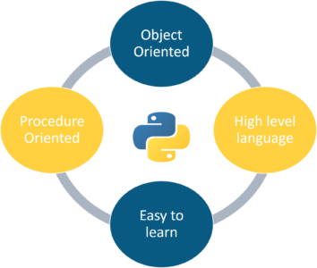
Introduction to Python

Slide 15
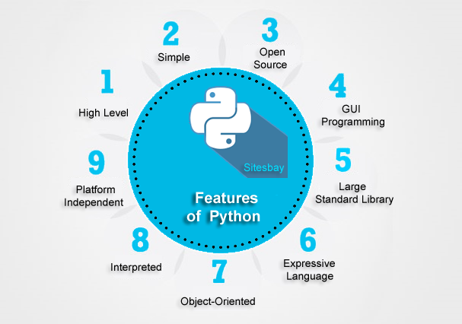

Slide 16
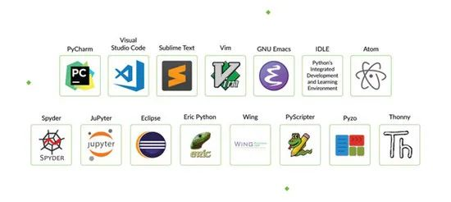
Python IDEs

Slide 17
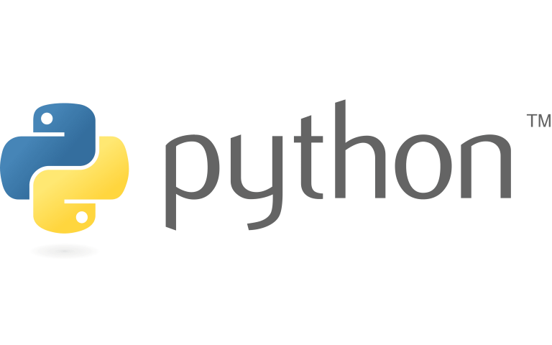
Introduction to Python Programming
 | Meaning and history The Python logo, designed by Tim Parkin. The emblem depicts a two-colored snakes image, which was based on the ancient Mayan drawings. They usually represented a python with a shortened tail and a big head. The Python wordmark in all the lowercase lettering is executed in a fine and elegant sans-serif typeface, where the upper parts of “T” and “H” are diagonally cut.

Slide 18
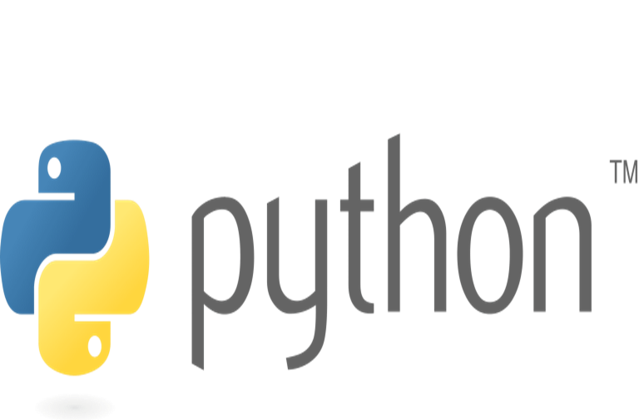
Introduction to Python Programming
Variables
Identifiers
Constants
Data types
Operators
Operator Precedence

Slide 19
Introduction to Python Programming
Python is a general-purpose, interpreted, object-oriented programming language.
Python was created by Guido van Rossum at National Research Institute for Mathematics and Computer Science, Netherlands in 1990 and was named after the popular British comedy troupe Monty Python’s Flying Circus.
Python is a general-purpose programming language.
Python is interpreted, which means that Python code is translated and executed by an interpreter, one statement at a time.

Slide 20
Introduction to Python Programming
Python is an object-oriented programming (OOP) language. Data in Python are objects created from classes. A class is essentially a type or category that defines objects of the same kind with properties and methods for manipulating objects.
Two versions of Python are currently coexistent: Python 2 and Python 3. The programs written in Python 3 will not run in Python 2. Python 3 is a newer version, but it is not backward-compatible with Python 2. This means that if you write a program using the Python 2 syntax, it may not work with a Python 3 interpreter.
Python provides a tool that automatically converts code written in Python 2 into syntax Python 3 can use. Python 2 will eventually be replaced by Python 3.

Slide 21
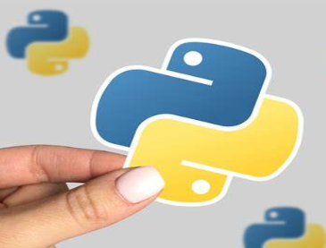
Introduction to Python Programming
Python 1.0 released on January, 1994.
Python 2.0 released on 16th Oct, 2000.
Python 3.0 released on 3rd Dec, 2008.
Python 3.10.2 released on 14th Jan, 2022 .
Python 3.11 released on 24th Oct,2022.
Python 3.12.4 released on 6th June, 2024

Slide 22
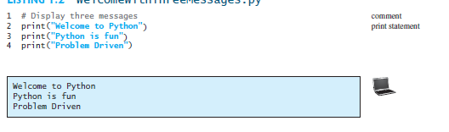
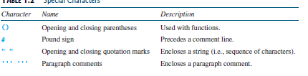
Introduction to Python Programming

Slide 23
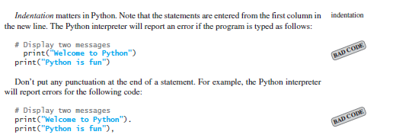
Introduction to Python Programming

Slide 24
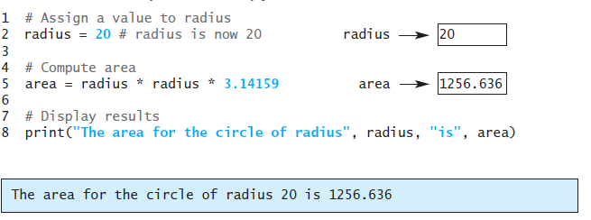
Introduction to Python Programming
Variable: Variable is a name that references a value stored in the computer’s memory. Variables such as radius and area reference values stored in memory. Every variable has a name that refers to a value

Slide 25
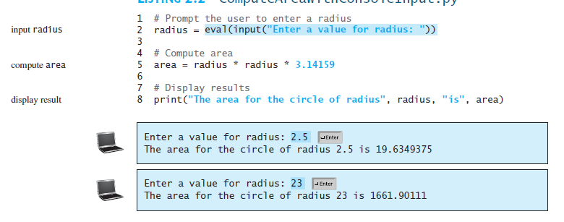
Introduction to Python Programming
Reading Input from console:
Reading input from the console enables the program to accept input from the user.
variable = input("Enter a value: ")

Slide 26
Introduction to Python Programming
Identifiers: Identifiers are the names that identify the elements such as variables and functions in a program.
All identifiers must obey the following rules:
An identifier is a sequence of characters that consists of letters, digits, and underscores (_).
An identifier must start with a letter or an underscore. It cannot start with a digit.
An identifier cannot be a keyword.
An identifier can be of any length.
Python is case sensitive, area, Area, and AREA are all different identifiers.

Slide 27
Introduction to Python Programming
Named Constants: A named constant is an identifier that represents a permanent value.
The value of a variable may change during the execution of a program, but a named constant (or simply constant) represents permanent data that never changes.
Python does not have a special syntax for naming constants.
If you have to change the constant’s value (e.g., from 3.14 to 3.14159 for PI), you need to change it only in a single location in the source code.
Descriptive names make the program easy to read.

Slide 28
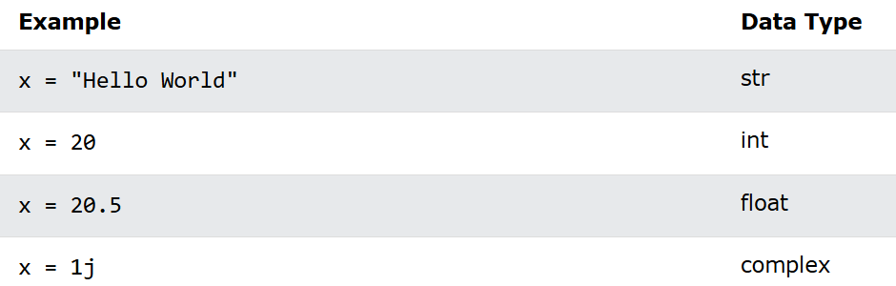
Introduction to Python Programming
Data Types in Python:
int: Represents integer values. Example: x = 5
float: Represents floating-point numbers (decimal values). Example: y = 3.14
complex: These numbers have a real part and an imaginary part. Example: a + bj
boolean: Booleans represent True or False.
string: These are sequences of characters enclosed in single, double, or triple quotes.

Slide 29
Introduction to Python Programming
Functions in Python: A function is a block of code which only runs when it is called. You can pass data, known as parameters, into a function. A function can return data as a result.
id():The id() function returns a unique identifier for a given object. This identifier is unique and constant for the object during its lifetime.
type(): The type() function in Python is used to determine the type of an object. This function returns the type of the specified object.
return(): The range() function generates a sequence of numbers, which is often used for looping a specific number of times in for loops. It can take one, two, or three arguments: range(stop), range(start, stop), or range(start, stop, step).

Slide 30
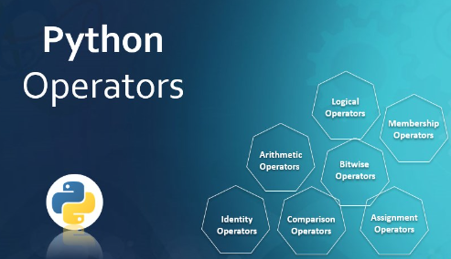
Introduction to Python Programming
Operators in Python
In Python, operators are special symbols or keywords that perform operations on variables and values. They are used to perform computations, comparisons, and logical operations.
i) Arithmetic Operators
ii) Relational Operators
iii) Assignment Operator
iv) Logical Operators
v) Bitwise Operators
vi) Ternary Operator
vii) Membership Operators
viii) Identity Operators

Slide 31
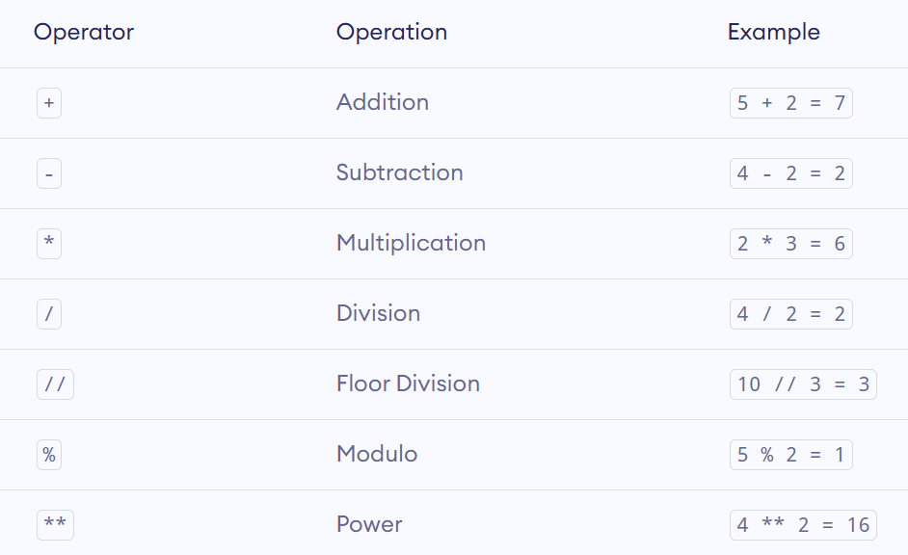
Introduction to Python Programming
Arithmetic Operators: Arithmetic operators are used to perform mathematical operations like addition, subtraction, multiplication, etc.

Slide 32
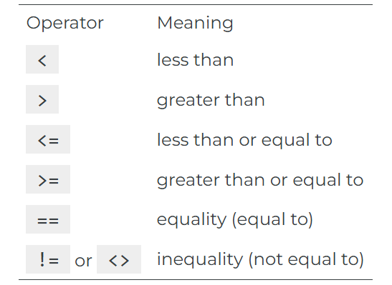
Introduction to Python Programming
Relation Operators: Relational operators are used to compare two values. A relational operator is a programming language construct or operator that tests or defines some kind of relation between two entities. These include numerical equality (e.g., 5 = 5) and inequalities (e.g., 4 ≥ 3).

Slide 33
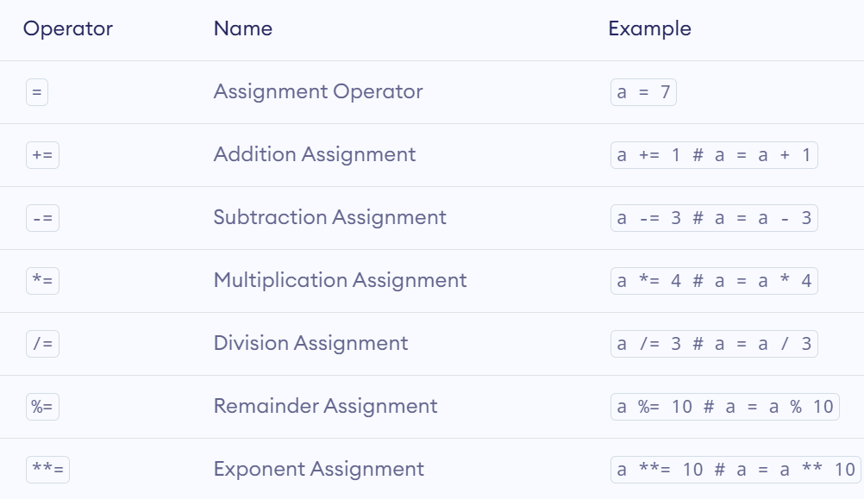
Introduction to Python Programming
Assignment Operators: The operators +, -, *, /, //, %, and ** can be combined with the assignment operator (=) to form augmented assignment operators.

Slide 34
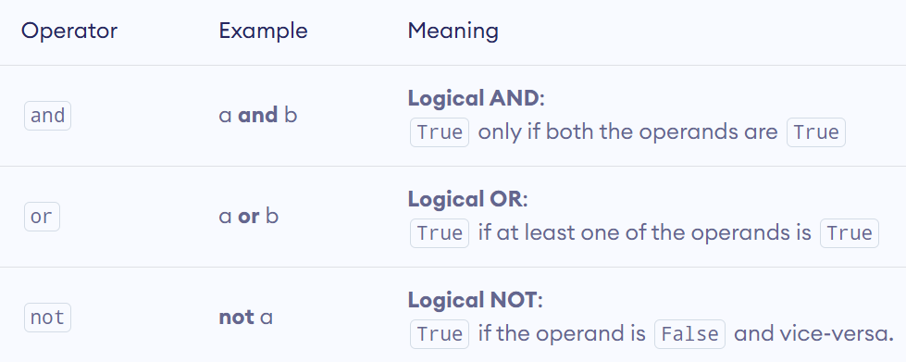
Introduction to Python Programming
Logical Operator: Logical operators are used to check whether an expression is True or False. They are used in decision-making. The primary logical operators in Python are and, or, and not. These operators allow you to create complex conditional statements by combining simpler conditions.

Slide 35
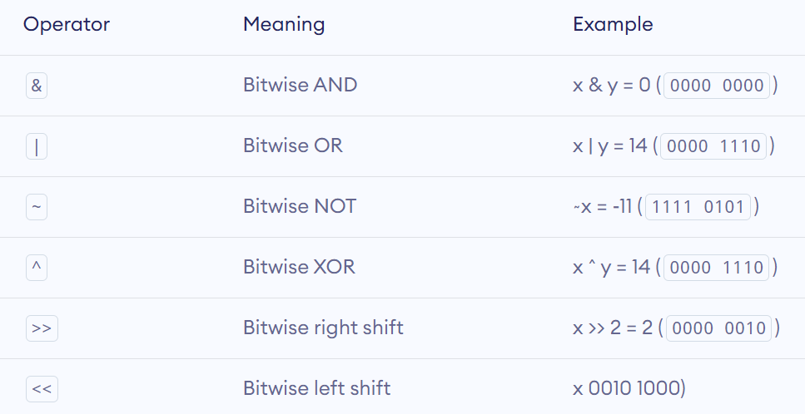
Introduction to Python Programming
Bitwise operator: Bitwise operators act on operands as if they were strings of binary digits. They operate bit by bit, hence the name.
For example, 2 is 10 in binary, and 7 is 111.

Slide 36
Introduction to Python Programming
Ternary Operator: The ternary operator in Python, also known as the conditional expression, provides a concise way to evaluate a condition and choose between two outcomes. This operator can be written in a single line, making your code shorter and more readable.
Syntax: true_value if condition else false_value

Slide 37
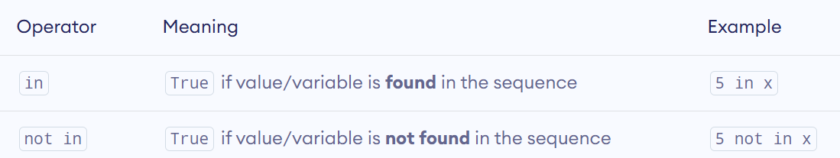
Introduction to Python Programming
Membership Operators: In Python, in and not in are the membership operators. They are used to test whether a value or variable is found in a sequence (string, list, tuple, set and dictionary).

Slide 38
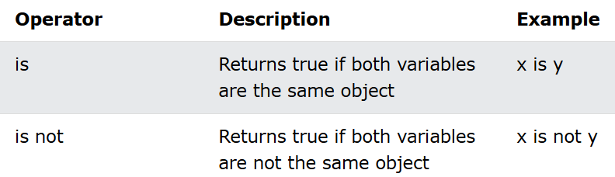
Introduction to Python Programming
Identity Operators: Identity operators are used to compare the objects, not if they are equal, but if they are actually the same object, with the same memory location:

Slide 39
Introduction to Python Programming
Conditional Statements: Conditional statements in Python allow you to execute different blocks of code based on whether a specific condition is true or false. The three main types of conditional statements in Python: if, if-else, and if-elif-else.
Python supports the usual logical conditions from mathematics:
Equals: a == b
Not Equals: a != b
Less than: a < b
Less than or equal to: a <= b
Greater than: a > b
Greater than or equal to: a >= b
An "if statement" is written by using the ‘if’ keyword.

Slide 40
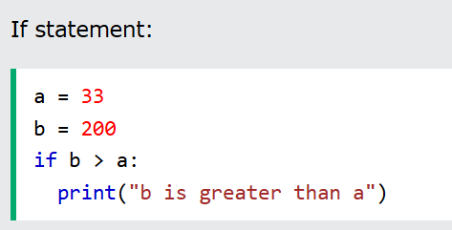
Introduction to Python Programming
If statement: The if statement is used to execute a block of code only if a specified condition is true.
Syntax:
if condition:
# Code to execute if condition is true

Slide 41
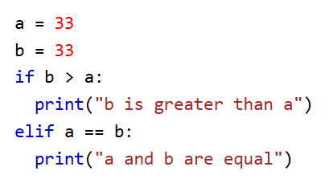
Introduction to Python Programming
Elif statement: The elif keyword is pythons way of saying "if the previous conditions were not true, then try this condition".
Syntax:
if (condition):
#statement
elif (condition):
#statement

Slide 42
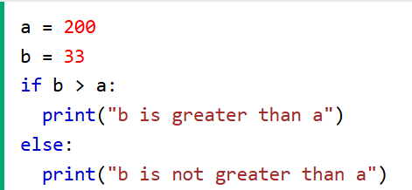
Introduction to Python Programming
If-else statement: The if-else statement is used to execute one block of code if the condition is true, and another block if the condition is false.
Syntax:
if condition:
# Code to execute if condition is true
else:
# Code to execute if condition is false

Slide 43
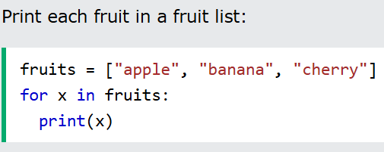
Introduction to Python Programming
Iterative statement: In Python, iterative statements, also known as loops, are used to execute a block of code repeatedly as long as a specified condition is true. There are several types of iterative statements available in Python, including for loops, while loops, and nested loops.
for Loop: The for loop is used to iterate over a sequence (such as a list, tuple, string, or range) and execute a block of code for each item in the sequence.
Syntax:
for item in sequence:
# Code to execute for each item

Slide 44
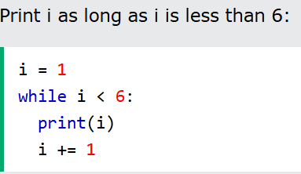
Introduction to Python Programming
While loop: The while loop is used to execute a block of code as long as a specified condition is true.
Syntax:
while condition:
# Code to execute as long as condition is true

Slide 45
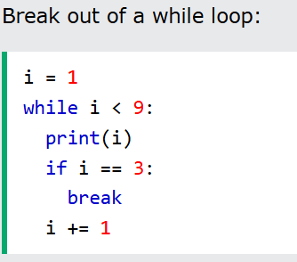
Introduction to Python Programming
Control transfer statements: Control transfer statements in Python are used to alter the flow of execution within loops and conditional statements. The main control transfer statements are break, continue, and pass.
i) break Statement: The break statement is used to exit a loop prematurely, regardless of whether the loop's condition is still true.
Syntax:
for item in sequence:
if condition:
break

Slide 46
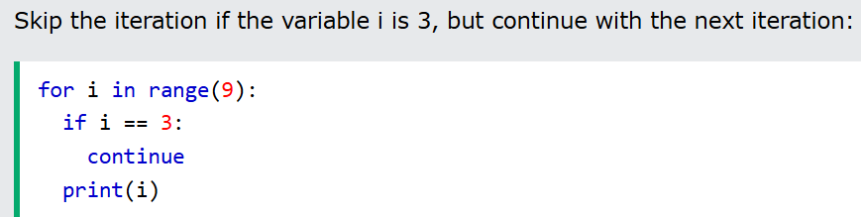
Introduction to Python Programming
ii) Continue Statement: The continue statement is used to skip the current iteration of a loop and proceed to the next iteration.
Syntax:
for item in sequence:
if condition:
continue

Slide 47
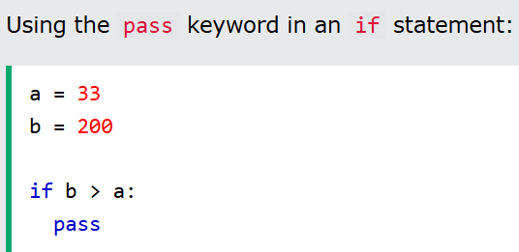
Introduction to Python Programming
iii) Pass Statement: The pass statement is a null operation that does nothing. It is typically used as a placeholder when a statement is syntactically required but no action is needed.
Syntax:
if condition:
pass

Slide 48
Python Function
Function provide a way to break problems or processes down into smaller and independent blocks of code.
Functions can be used to define reusable code and organize and simplify code.
Function is a block of code which performs a specific task.
Function improves efficiency and reduces errors because of the reusability of a code.
Code readability

Slide 49
Python Function
Types of Functions : Python support two types of functions:
Built-in function : The functions which are come along with Python itself are called a built-in function or predefined function. Some of them are listed below.
range(), id(), type(), print(), input(), eval() etc.
User-defined function: Functions which are created by programmer explicitly according to the requirement are called a user-defined function.

Slide 50
Python Function
Defining a Function: A function definition consists of the function’s name, parameters, and body.
The syntax for defining a function is as follows:
def functionName(list of parameters):
# Function body
def: def is a keyword for defining a function.
FunctionName: Function name is the name of the function that can be give any name to function. A function name to uniquely identify the function.
List of parameters: Arguments through which pass values to a function. They are optional.
A colon (:) to mark the end of the function header.

Slide 51
Python Function
Calling a Function: Calling a function executes the code in the function.
To call a function, use the name of the function with the parenthesis, and if the function accepts parameters, then pass those parameters in the parenthesis.
A called function returns control to the caller when its return statement is executed or the function is finished.
Return Statement: The return statement is used to exit a function and go back to the place from where it was called. Syntax of return: return [expression_list]
This statement can contain an expression that gets evaluated and the value is returned.
If there is no expression in the statement or the return statement itself is not present inside a function, then the function will return the nothing object.

Slide 52
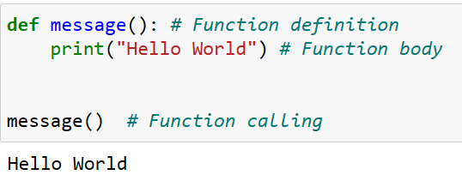
Python Function
Example:

Slide 53
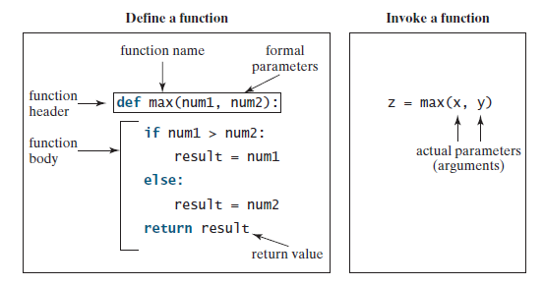
Python Function
Example:

Slide 54
Python Function
Formal Parameters: The variables in the function header are known as formal parameters or simply parameters.
Actual Parameter : When a function is invoked, you pass a value to the parameter. This value is referred to as an actual parameter or argument. Parameters are optional; that is, a function may not have any parameter.

Slide 55
Python Function
Scope and Lifetime of Variables: Scope of a variable is the portion of a program where the variable is recognized. Parameters and variables defined inside a function are not visible from outside the function. Hence, they have a local scope.
The lifetime of a variable is the period throughout which the variable exits in the memory. The lifetime of variables inside a function is as long as the function executes.
They are destroyed once we return from the function. Hence, a function does not remember the value of a variable from its previous calls.
A Global variable is a variable that declares outside of the function. The scope of a global variable is broad. It is accessible in all functions of the same module.

Slide 56
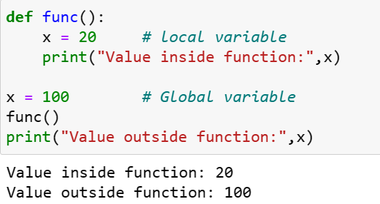
Python Function
Example of local and global variables:

Slide 57
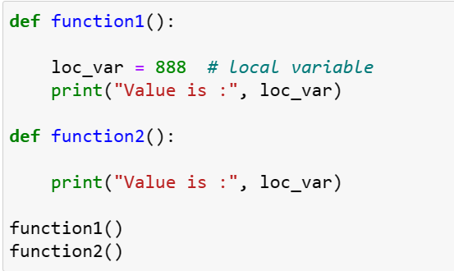
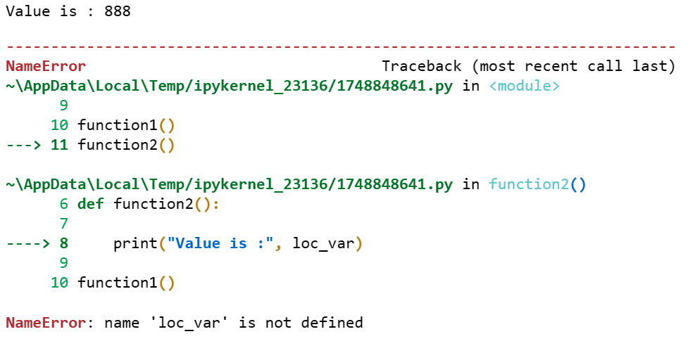
Python Function

Slide 58
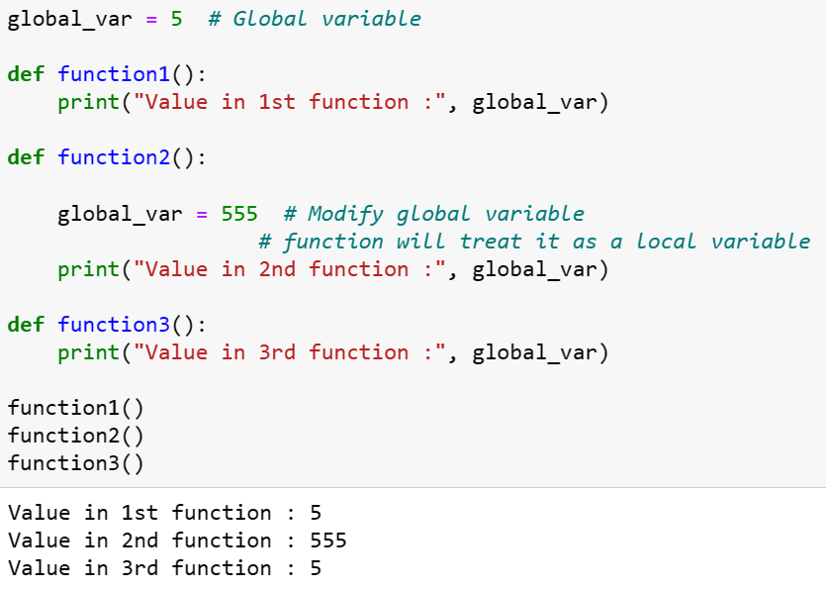
Python Function
Example of local and global variables:

Slide 59
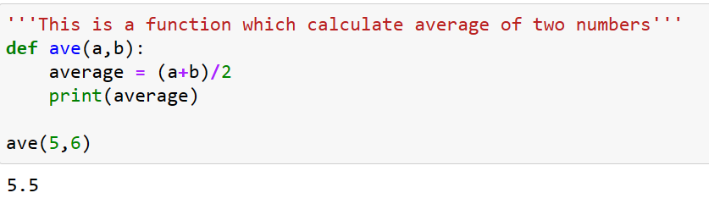
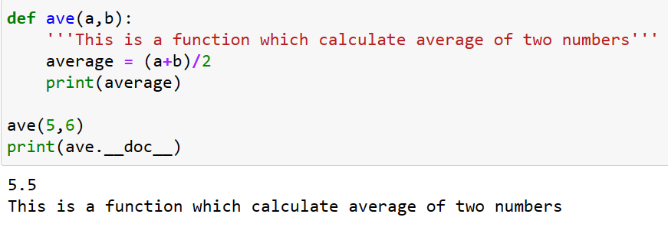
Python Function
Docstring: Python docstrings are strings used right after the definition of a function, method, class, or module. They are used to document the code.
To access the docstrings using the __doc__ attribute.

Slide 60
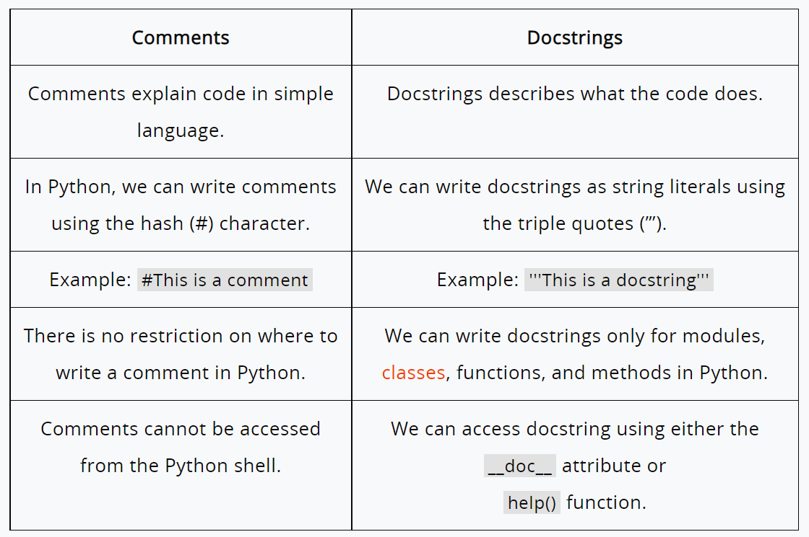
Python Function
Difference between comments and docstring

Slide 61
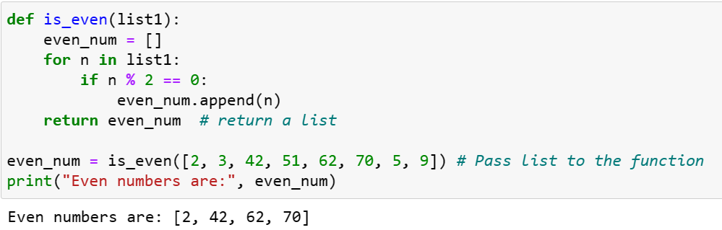
Python Function
Return Value From a Function: In Python, to return value from the function, a return statement is used. It returns the value of the expression following the returns keyword. The return statement should be inside of the function block. (function with list)

Slide 62
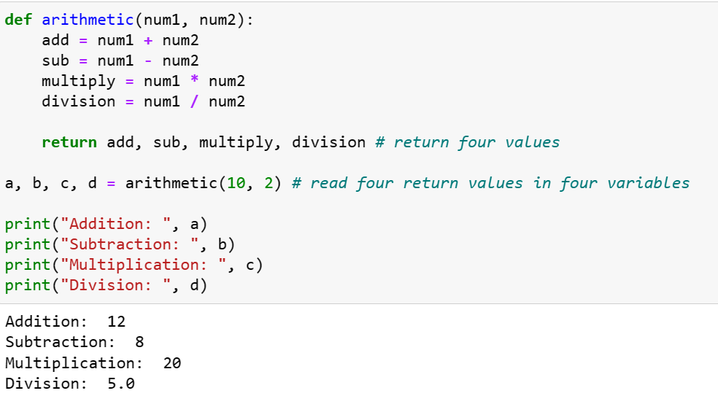
Python Function
Return Multiple Values: It return multiple values from a function. Use the return statement by separating each expression by a comma.

Slide 63
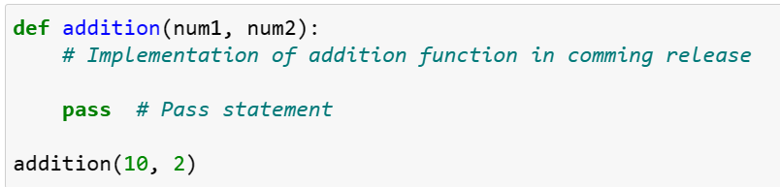
Python Function
pass Statement in function: When the interpreter finds a pass statement in the program, it returns no operation.

Slide 64
Call by Value
When the object you are passing to the function is immutable than it means we are passing arguments using Call by value.
def myFunction(name1):
name1 = "Hello India"
print("Inside Function:",name1)
name = "Deepak Vats"
myFunction(name)
print("Outside Function:",name)
OUTPUT:
Inside Function: Hello India
Outside Function: Deepak Vats

Slide 65
Call by Reference
When the object you are passing to the function is mutable than it means we are passing arguments using Call by reference.
def myFunction(myList1):
myList1.append(1004)
print("Inside Function myList is:",myList1)
myList = [1001, 1002, 1003]
myFunction(myList)
print("Outside Function myList is:",myList)
OUTPUT:
Inside Function myList is: [1001, 1002, 1003, 1004]
Outside Function myList is: [1001, 1002, 1003, 1004]

Slide 66
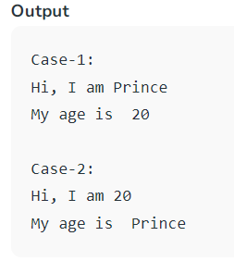
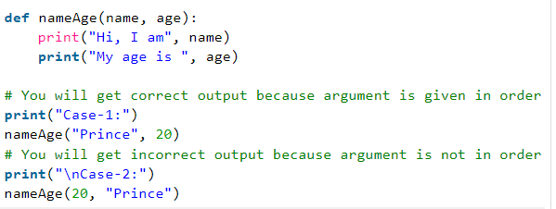
Python Function
Positional Arguments:
Position-only arguments mean whenever we pass the arguments in the order we have defined function parameters in which if you change the argument position then you may get the unexpected output. We should use positional Arguments whenever we know the order of argument to be passed. So now, we will call the function by using the position-only arguments in two ways and In both cases, we will be getting different outputs from which one will be correct and another one will be incorrect.Example:

Slide 67
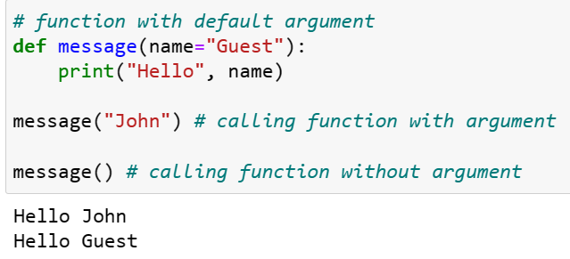
Python Function
Default Arguments: Function arguments can have default values in Python. Default value to an argument in function definition using the = assignment operator.

Slide 68
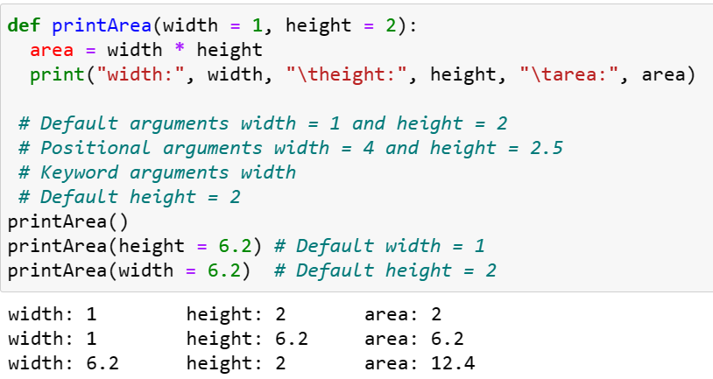
Python Function
Default Arguments

Slide 69
Keyword Arguments
You can also send arguments with the key = value syntax.
This way the order of the arguments does not matter.
def myFunction(fname,lname):
print("Fname:",fname)
print("Lname:",lname)
myFunction(lname="Vats",fname="Deepak")
Note: Here myFunction() is called by passing lname argument at first place even through it is the second argument in Function definition.

Slide 70
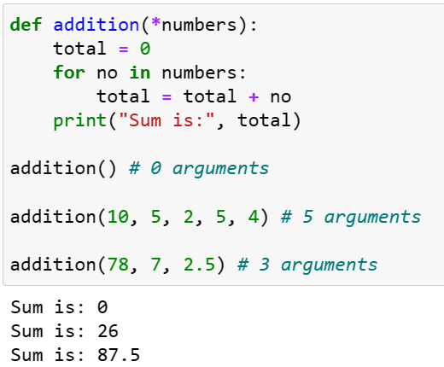
Python Function
Arbitrary Arguments: Sometimes, we do not know in advance the number of arguments that will be passed into a function. Python allows us to handle this kind of situation through function calls with an arbitrary number of arguments. In the function definition, we use an asterisk (*) before the parameter name to denote this kind of argument.

Slide 71
Arbitrary Keyword Arguments, **kwargs
If you do not know how many keyword arguments that will be passed into your function, add two asterisk: ** before the parameter name in the function definition.
This way the function will receive a dictionary of arguments, and can access the items accordingly.
def myFunction(**name):
for i in name:
print(name[i])
myFunction(lname="Vats",fname="Deepak")
myFunction(lname="Vats",fname="Deepak",UID = "191001")
Note: Here myFunction() is called by passing arbitrary number of keyword arguments.

Slide 72
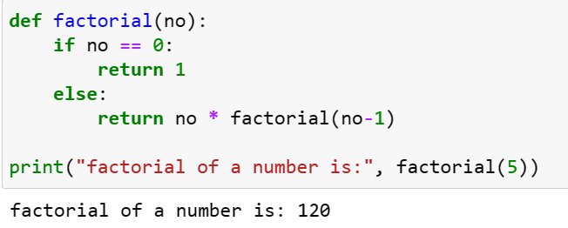
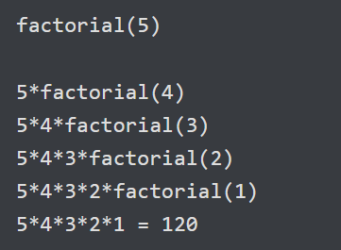
Python Function
Recursive Function: A recursive function is a function that calls itself, again and again.
Consider, calculating the factorial of a number is a repetitive activity, in that case, we can call a function again and again, which calculates factorial.

Slide 73
Python Function
Lambda Functions: In Python, an anonymous function is a functions that is defined without a name.
While normal functions are defined using the def keyword in Python, anonymous functions are defined using the lambda keyword.
Hence, anonymous functions are also called lambda functions.
Syntax: Lambda arguments: expression
Lambda functions can have any number of arguments but only one expression. The expression is evaluated and returned.
Lambda functions can be used wherever function objects are required.

Slide 74
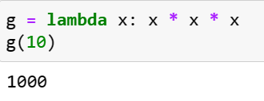



Python Function
Lambda Functions

Slide 75

Python Function
difference between def() and lambda() function

Slide 76

Python Function
Nested Function: A nested function is simply a function within another function, and is sometimes called an "inner function".
Defining an Inner Function: o define an inner function in Python, we simply create a function inside another function using the Python’s def keyword.

Slide 77
Outcomes
Department of Computer Science and Engineering (CSE)
•Understand and apply Python's basic data types and variables, demonstrating the ability to use built-in functions like id(), type(), and range().
•Comprehend and utilize Python's operators and control structures, including the proper use of control transfer statements.
•Design and implement functions in Python, demonstrating proficiency in using different types of arguments.

Slide 78
References
Department of Computer Science and Engineering (CSE)
Ashok Namdev Kamthane, Programming and Problem Solving with Python, Mc Graw Hill Education Publication,1st Edition, November 2017.
Kenneth Lambert, Fundamentals of Python :First Programs,Cengage Learning.
Allen Downey, Think Python, O'Reilly Media, 2ndEdition,2015.
Rajaraman V,” Computer Oriented Numerical Methods”, Pearson Education.

Slide 79



Department of Computer Science and Engineering (CSE)

